Slide 1
State HACC 2017 WANTED: UH Map App
Garret T. Yoshimi
VP for IT & CIO

Slide 2
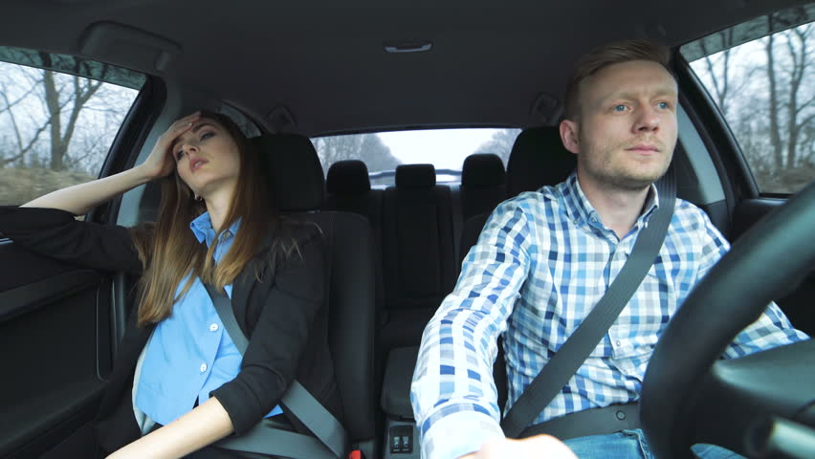

Slide 3


Slide 4
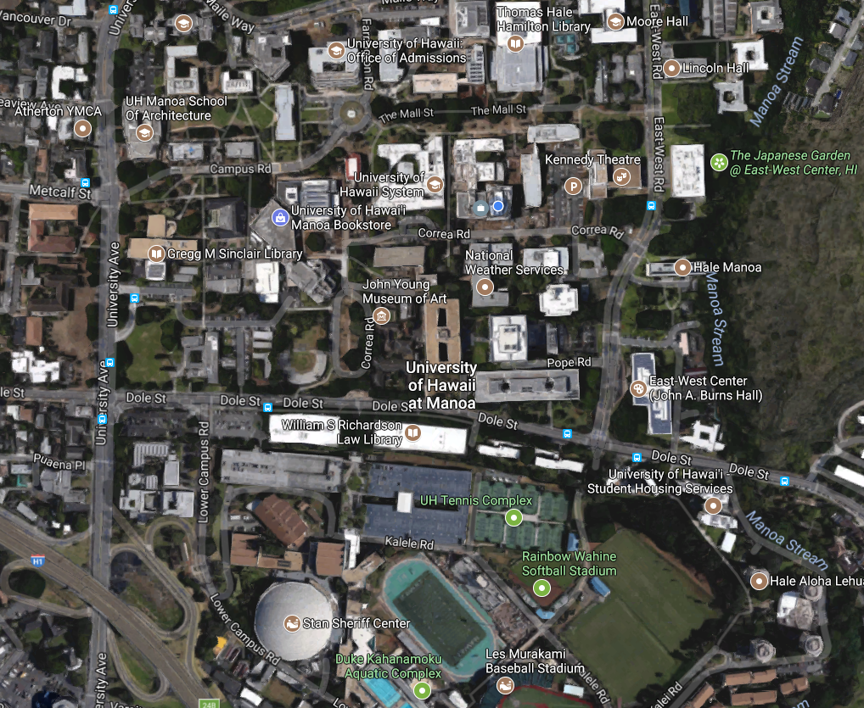

Slide 5
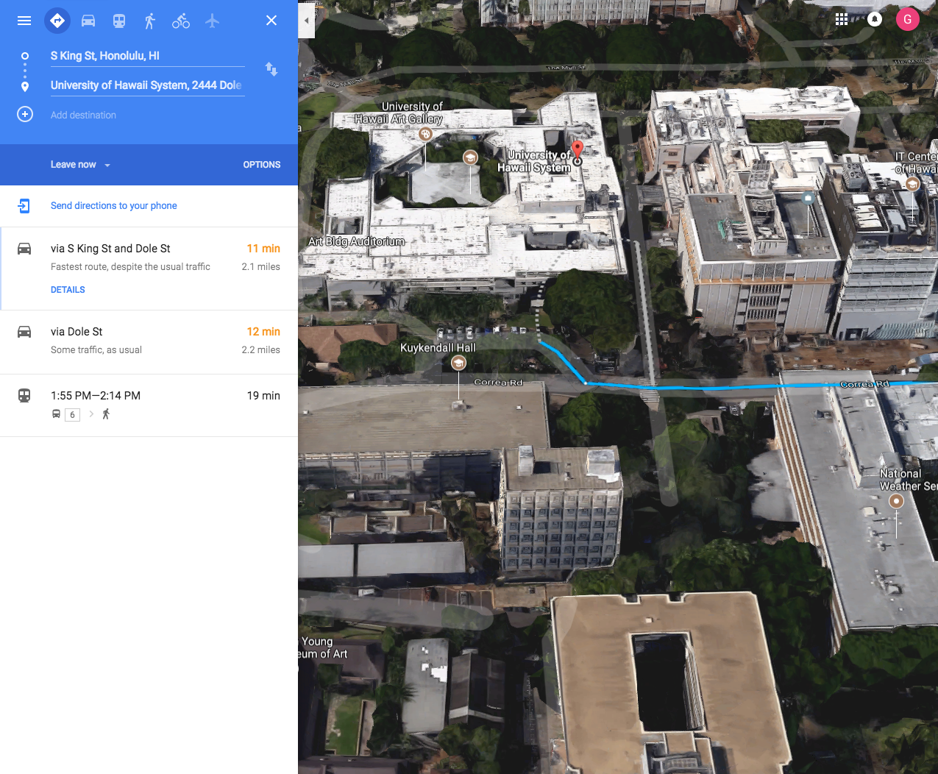
Notes:
Current: Google Maps: Find University of Hawaii System (note address as 2444 Dole Street) ... this is the Art Building on Correa Road

Slide 6
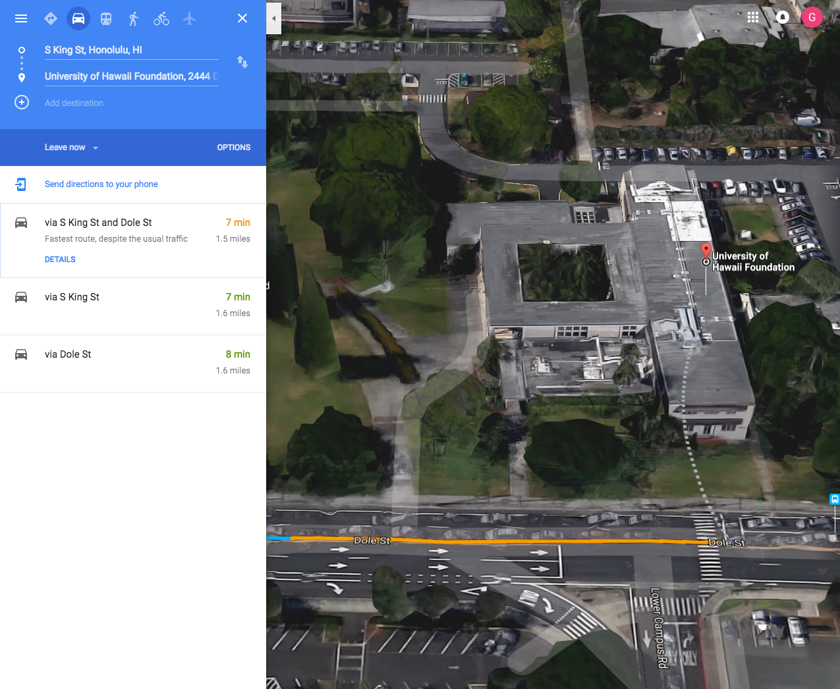
Notes:
Current: Google Maps, Drive to Bachman Hall (Finds University of Hawaii Foundation)

Slide 7
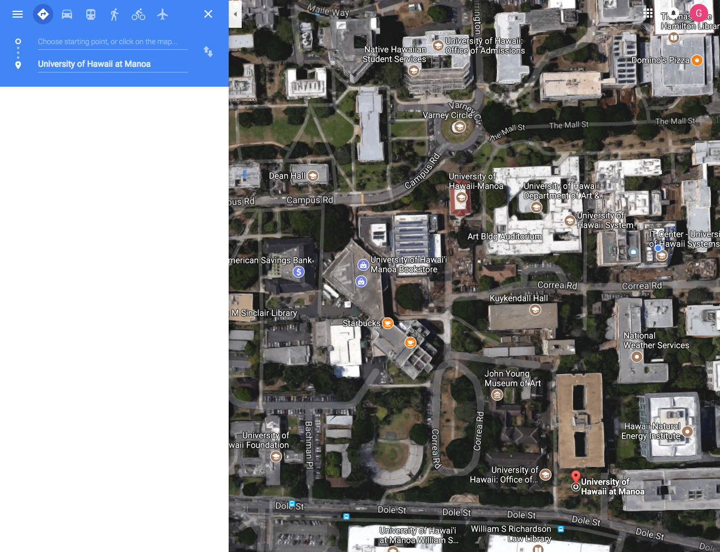
Notes:
Current: Google Maps: Find University of Hawaii at Manoa

Slide 8
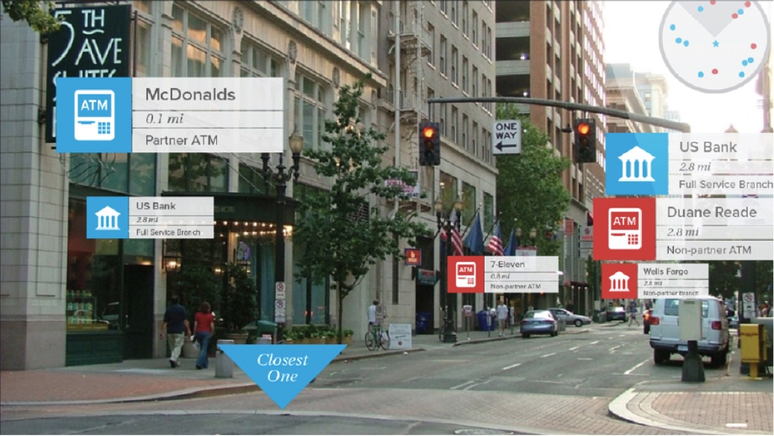
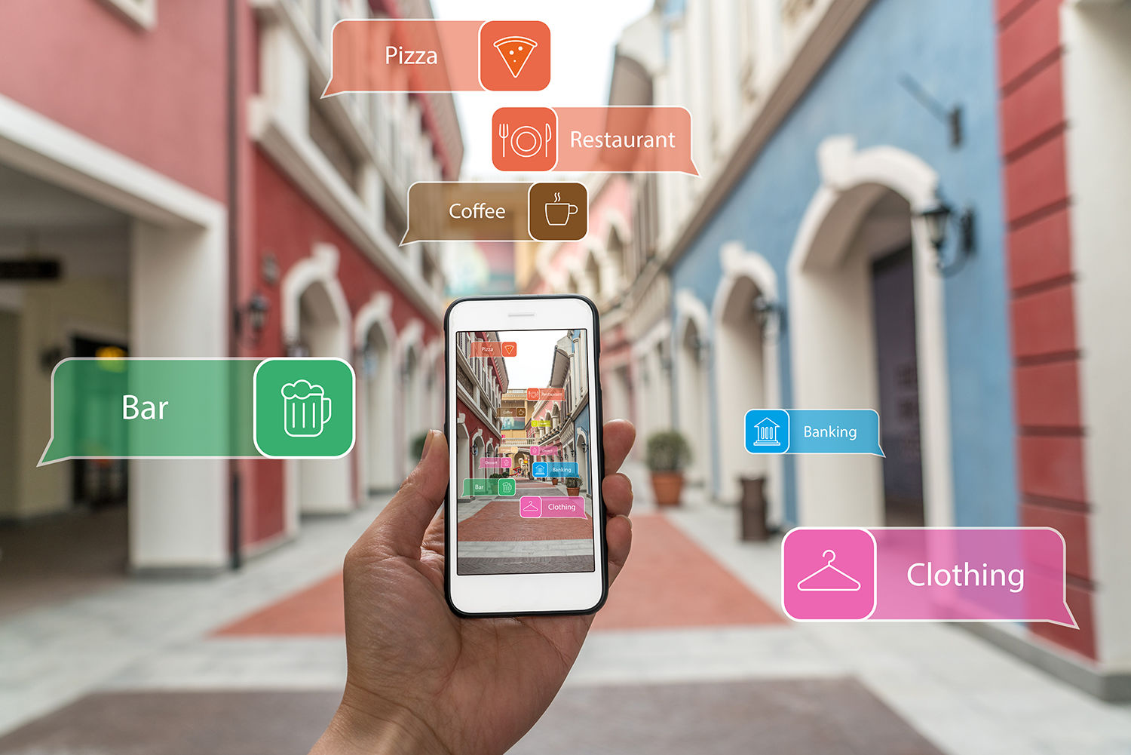
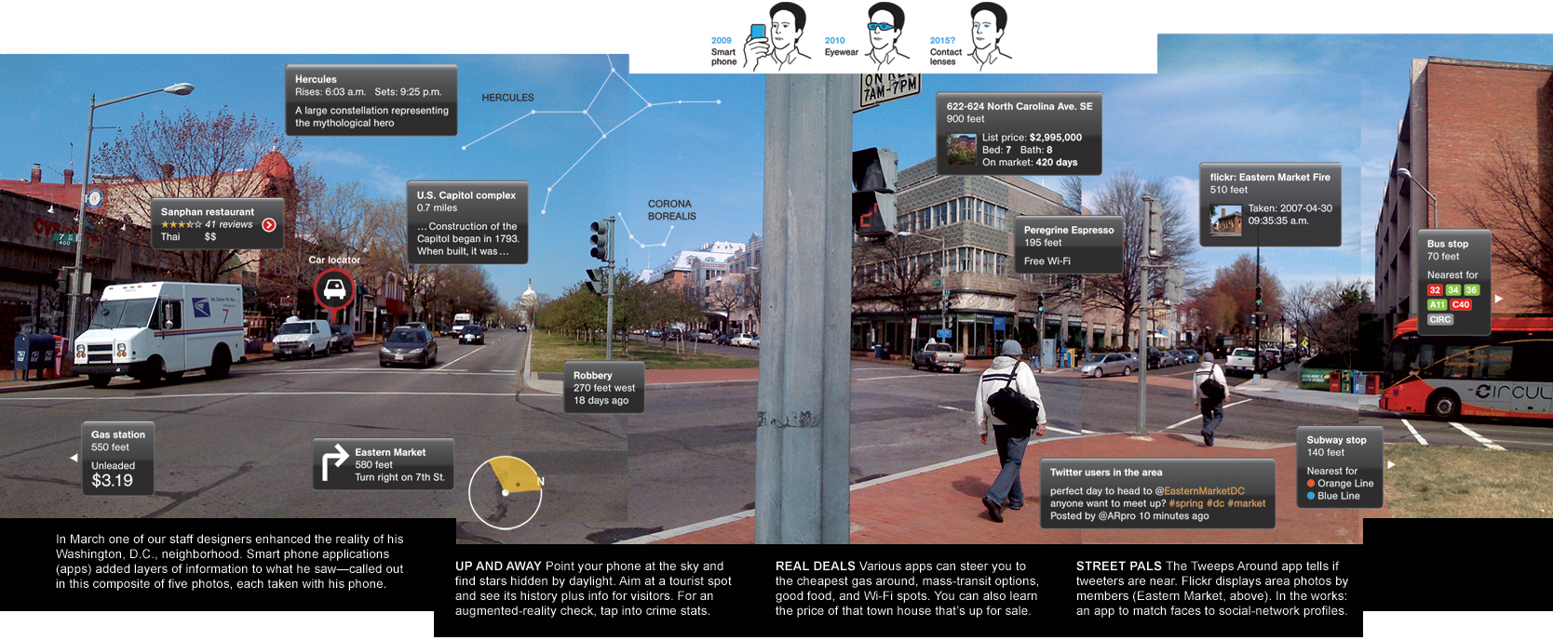
Notes:
An Augmented View

Slide 9
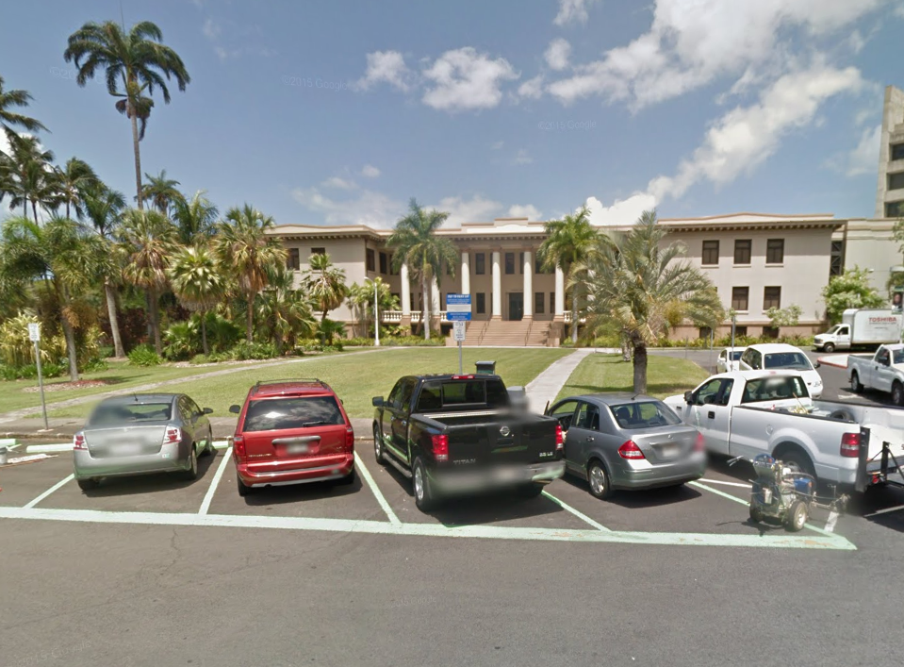
Hawaii Hall
Chancellor’s Office #301
Visitor Parking
Notes:
Possibilities: Visiting the Chancellor at Hawaii Hall

Slide 10
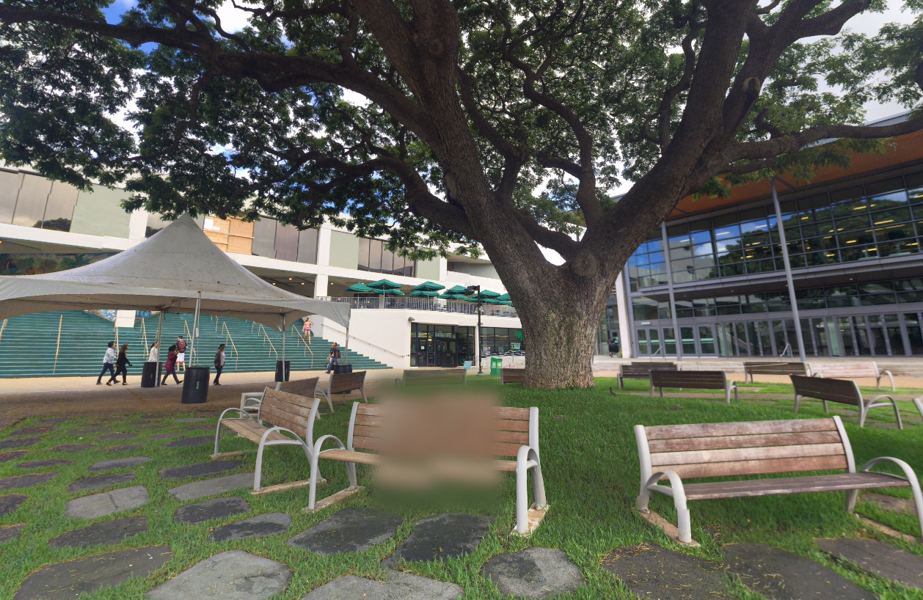
Campus Center
Starbucks
Warrior Rec Center
Bookstore
Notes:
Possibilities: Bookstore and Starbucks @ Campus Center

Slide 11
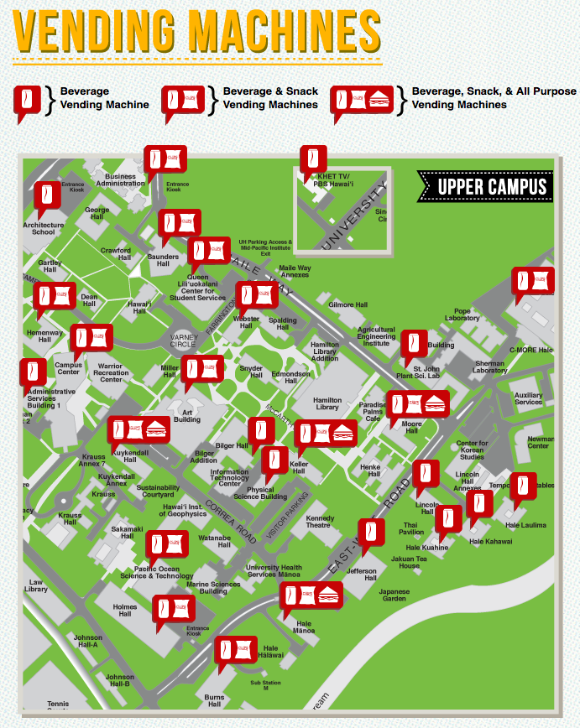

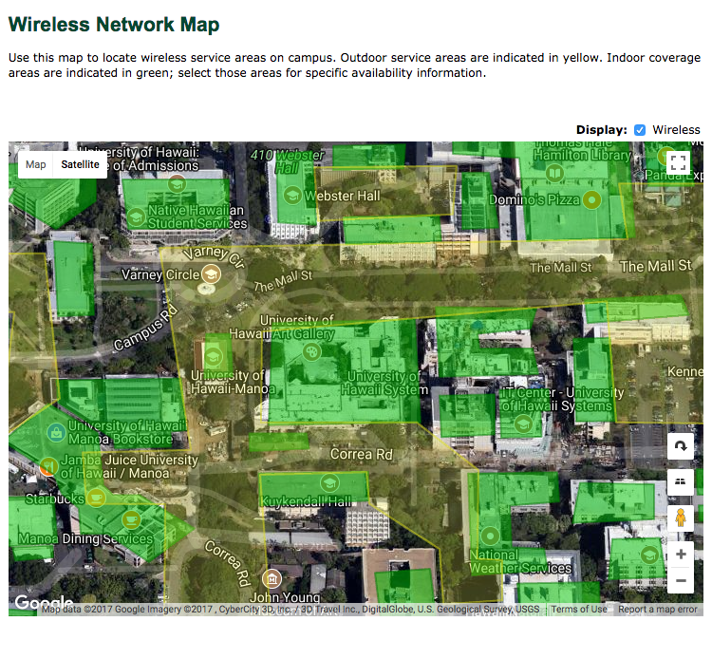
Notes:
Opportunities for additional layers

Slide 12
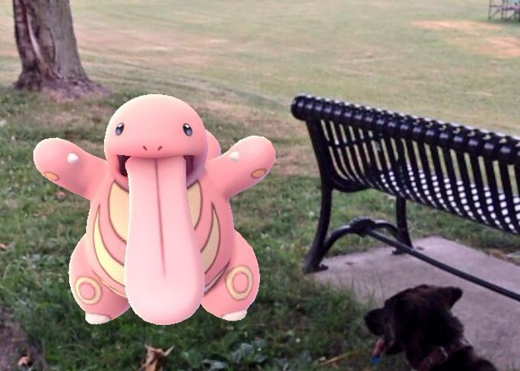
WANTED: UH Map App
gyoshimi@hawaii.edu

Slide 13
Thank You!

